Slide 1
Boeing Cloud Implementation
Anirban Sarkar (Data Scientist, BT&E)
Ashutosh Jha (Data Scientist, Boeing AI)

Slide 2

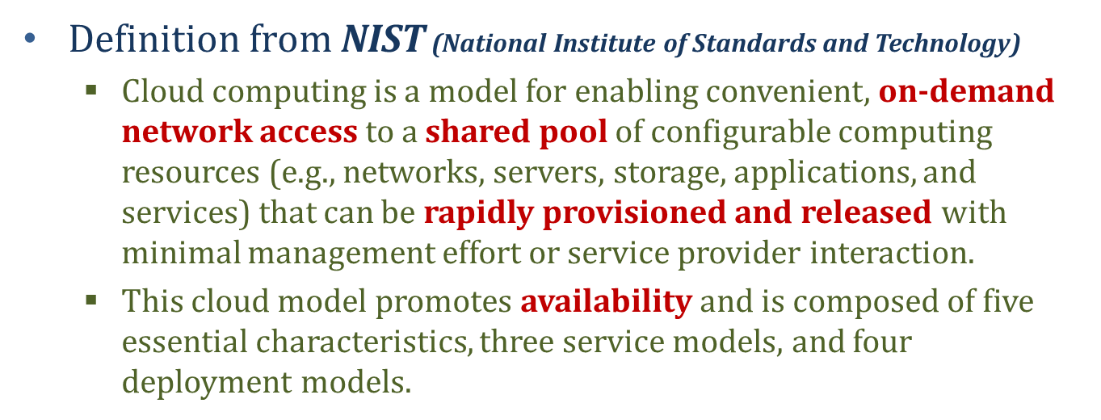
What is Cloud Computing?

Slide 3
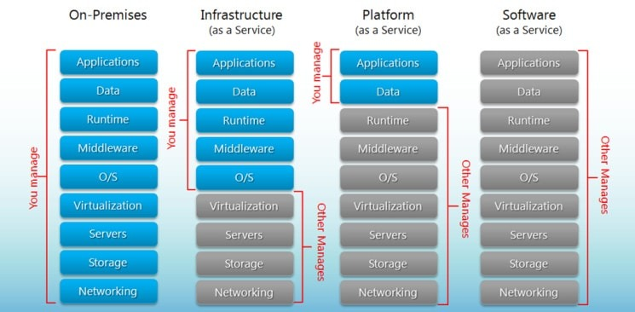
Cloud Strategy Approach
Cloud SaaS Strategy
Move commoditized processes to SaaS as required capabilities are met.
Cloud PaaS Strategy
Move specific processes to PaaS as investments allow.
Cloud IaaS Strategy
Move the rest to IaaS

Slide 4
Docker: From "It Works on My Machine" to Everywhere.
An In-Depth Guide to Containers, Volumes, & Compose

Slide 5
The Problem We All Face
"But... it works on my machine!"
"
"
— Every Developer, At Some Point
This is the classic, frustrating problem that ruins deployments and wastes countless hours.

Slide 6

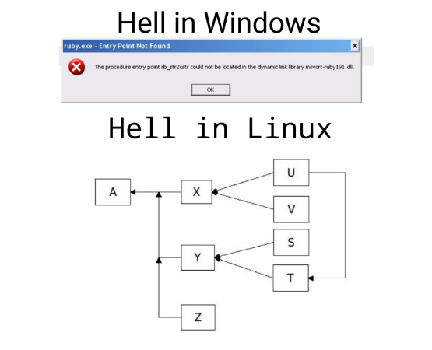
What Causes This?
The "Matrix of Hell"
Why does this happen? The environment is different! Your code isn't the only thing that matters. Its environment does, too.
•
Different OS (Mac vs. Linux vs. Windows)
•
Different library versions (Python 3.8 vs 3.9)
•
Different databases (PostgreSQL 12 vs 14)
•
Different environment variables & configs
•
Subtle file path differences (/user/ vs C:\)

Slide 7

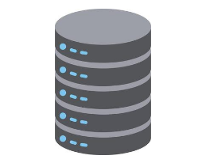
The "Old" Solution: Virtual Machines
Virtual Machines (VMs)
For years, we solved this with VMs. A VM is a complete, emulated computer running inside your *actual* computer.
•
It bundles a full Guest Operating System.
•
It provides strong, hardware-level isolation.
•
It reliably creates a consistent environment.

Slide 8
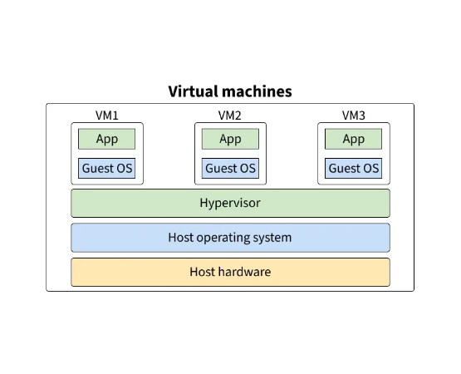
VM Architecture: The Heavyweight
How VMs Work
This diagram shows why VMs are so heavy. Each application has its own OS. This is a lot of waste.
•
Infrastructure: The physical server.
•
Hypervisor: Software that creates/runs VMs (e.g., VMWare, VirtualBox).
•
Guest OS: A *full* copy of an OS (e.g., 10GB of Ubuntu) for *each app*.

Slide 9
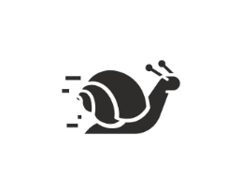
The Problem with VMs
The Drawbacks
While reliable, VMs have major drawbacks for modern, fast-paced development.
•
Heavy: Each VM is GigaBytes in size.
•
Slow: They take minutes to boot up (like a real computer).
•
Resource-Hungry: They consume a fixed, large amount of RAM and CPU, even when idle.
•
Poor Portability: A 20GB VM file isn't easy to "just send" to a co-worker.

Slide 10
A New Approach: Containers
We need the isolation of a VM, but the lightness and speed of a single process.

Slide 11
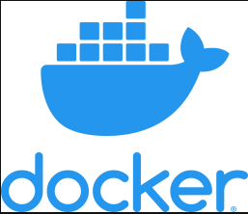
What is Docker?
The Modern Solution
Docker is a platform for developing, shipping, and running applications in containers.
It's a technology that provides OS-level virtualization, allowing us to package an application and its dependencies into a lightweight, isolated "container."
It's the tool that finally, and elegantly, solves the "it works on my machine" problem.
Notes:
A container is a lightweight, standalone, and executable package of software that includes everything needed to run an application: the code, runtime, system tools, libraries, and settings.

Slide 12
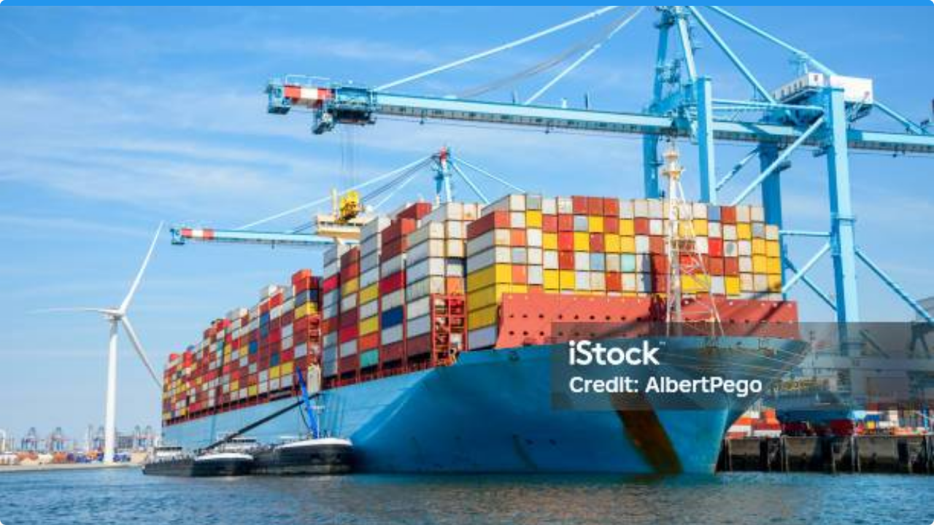

The Shipping Container Analogy
This is the most important concept. Before containers, loading a ship was chaotic (barrels, sacks, boxes). Standardized containers changed global trade. It doesn't matter *what's* inside the box; the ship, train, and crane can all handle it the same way.
Docker is the shipping container for software.

Slide 13
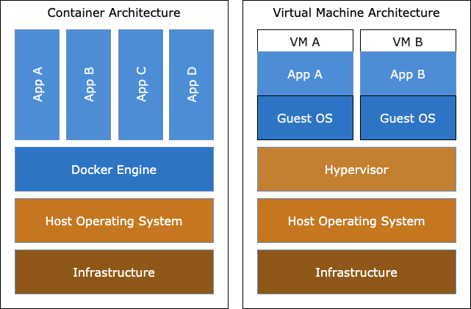
Container Architecture: The Lightweight
How Containers Work
This is why containers are so fast. They share the Host OS kernel.
•
Docker Engine: The software that runs and manages containers.
•
No Guest OS: The container only holds the app and its libraries (Bins/Libs).
•
Result: Starts in seconds, measured in MegaBytes.
Notes:
How Docker Operates Without a Guest OS
Containers Share the Host OS Kernel
Containers do not need a separate "guest OS" for each app.
Instead, all containers share the kernel of the host operating system.
Each container has its own isolated user space (file system, processes, network, etc.), but they all use the same underlying OS kernel.
What Does This Mean?
No need to boot a full OS for each app. This makes containers lightweight and fast.
The Docker Engine manages these isolated environments, ensuring each app thinks it has its own OS, but in reality, they are all using the host's kernel.
How Do Apps Run?
Each container includes everything the app needs to run: code, libraries, dependencies, and configuration files.
The container runs as a process on the host OS, isolated from other containers by the Docker Engine using kernel features like namespaces and cgroups

Slide 14
At a Glance: VMs vs. Containers
Feature | Virtual Machines | Containers
Size | Gigabytes (GBs) | Megabytes (MBs)
Start-up Time | Minutes | Seconds
Overhead | High (Full Guest OS) | Low (Shared Kernel)
Isolation | Hardware-level | OS-level (Process)
Analogy | A Full House | An Apartment / A Condo

Slide 15
The "How": Docker's Core Concepts
Let's look at the pieces that make Docker work.

Slide 16
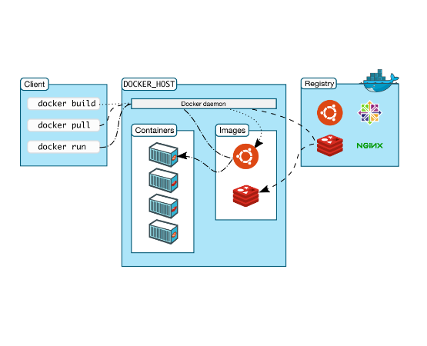
Core: The Docker Engine
Client-Server Architecture
Docker isn't just one thing. It's a client-server application.
•
Client: The `docker` command in your terminal.
•
Server (Daemon): A background service (`dockerd`) that listens for API requests.
•
API: The `docker` client talks to the daemon via a REST API.
When you type `docker run`, the client tells the daemon to run a container.
Notes:
dockerd is the Docker daemon—the background service that manages Docker containers, images, networks, and storage on your system.
Docker Engine is the official term for the core Docker software that runs containers. It includes:
The Docker daemon (dockerd)
The REST API
The CLI (docker)
Docker Server is not an official term, but some people use it informally to refer to the Docker Engine or the host running Docker.

Slide 17
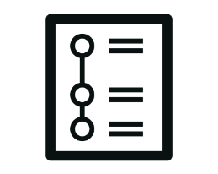
1. The Dockerfile
The Blueprint
This is the blueprint. A simple, human-readable text file with instructions to build an image.
•
`FROM python:3.9` - "Start with Python 3.9"
•
`COPY . /app` - "Copy my code into the /app folder"
•
`RUN pip install -r requirements.txt` - "Install my libraries"
•
`CMD ["python", "app.py"]` - "Set the default command to run"

Slide 18

2. The Image
The Template
An Image is the template, created from the Dockerfile.
•
It's a read-only snapshot.
•
It contains your application, all its dependencies, libraries, and configuration.
•
Images are built in layers. If you only change your code (not `requirements.txt`), Docker only rebuilds the final, small layer. This is very fast.
Notes:
How Docker Layers Work
Each instruction in your Dockerfile (like FROM, RUN, COPY, ADD, etc.) creates a new layer.
Layers are cached: If nothing changes in a layer, Docker reuses it to speed up builds.
Layers are read-only: Only the top layer (when running a container) is writable.
What does each layer do?
Here’s a breakdown of common Dockerfile instructions and what their layers contain:
FROMThe base image (e.g., python:3.9-slim). This is the first layer.
RUNThe result of running a command (e.g., installing packages, updating files).
COPY / ADD The files or directories copied into the image at this step.
ENV Environment variable settings for subsequent layers.
WORKDIR Sets the working directory for following instructions.
EXPOSE Metadata about which ports the container will listen on (does not actually open the port).
CMD / ENTRYPOINTThe default command to run when the container starts (not a layer, but metadata).
Why are layers important?
Caching: If you change a file or command, only that layer and the ones after it are rebuilt.
Efficiency: Layers are shared between images if they are identical, saving disk space and speeding up builds.
Portability: Each layer is stored as a separate object, so Docker can transfer only the layers you don’t already have.

Slide 19
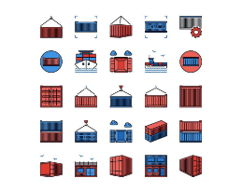
3. The Container
The Running Instance
A Container is a running instance of an image.
•
It's the live, executing "box" that runs your code.
•
It's lightweight, portable, and isolated.
•
You can start, stop, and delete containers.
•
You can run many containers from the same image. (e.g., 10 copies of your web server).

Slide 20
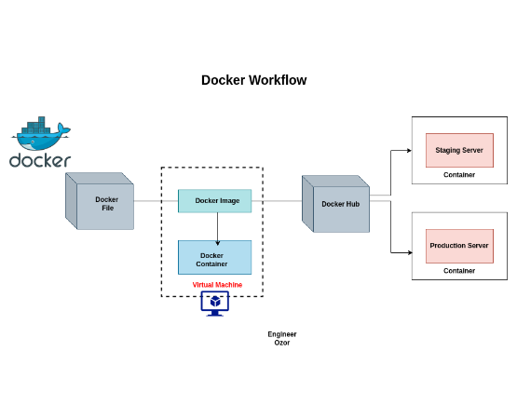
The Core Workflow
Build -> Run -> Share
This is the magic loop of Docker development.
1.
Write your `Dockerfile` (the blueprint).
2.
Build a read-only `Image` from the file (`docker build`).
3.
Run one or more `Containers` from that image (`docker run`).
4.
Share your `Image` on a registry (like Docker Hub) for others to use.

Slide 21
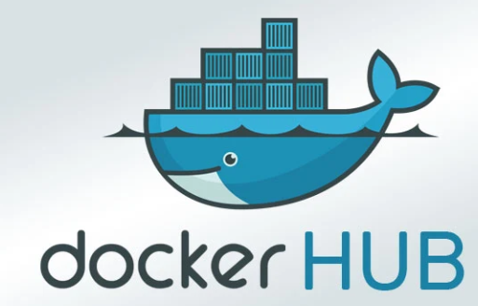
4. Registries (e.g., Docker Hub)
The Library
Where do you get images like `python:3.9`? From a Registry.
•
A registry is a library for storing and sharing Docker images.
•
Docker Hub is the default, public registry (like GitHub for code).
•
You `docker pull` official images (like Python, Ubuntu, Postgres).
•
You `docker push` your own custom images to share with your team.

Slide 22
The "Why": Benefits & Use Cases
Why has this taken over the tech industry?

Slide 23
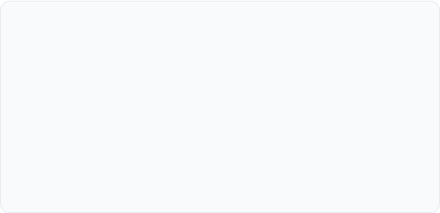
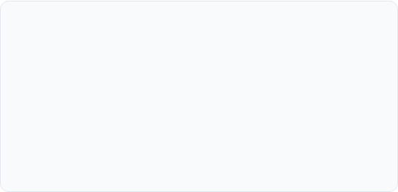


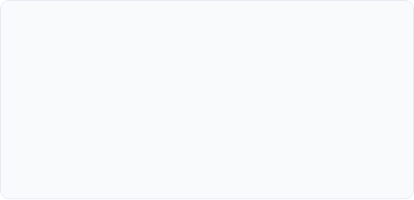



Key Benefits of Docker
Speed & Efficiency
Portability
Starts in seconds, uses minimal resources. Pack 10s of containers on a machine that could only run 1-2 VMs.
Your "box" runs on your Mac, your team's Windows, and the AWS Linux server identically. No more surprises.
Isolation
Reproducibility
Run Project A with Python 2.7 and Project B with Python 3.9 on the same machine with zero conflicts.
The Dockerfile guarantees every environment is built *exactly* the same, every time. Perfect for testing.

Slide 24
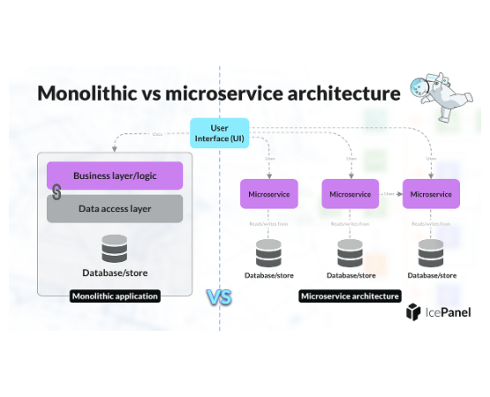
Use Case: Microservices
Small, Independent Services
Docker is the perfect tool for a microservice architecture.
•
Monolith: One giant application. If one part fails, the whole app might go down.
•
Microservices: Break the app into small, independent services (e.g., `users`, `products`, `cart`).
•
Each service runs in its own container, can be scaled independently, and can even be written in different languages!

Slide 25
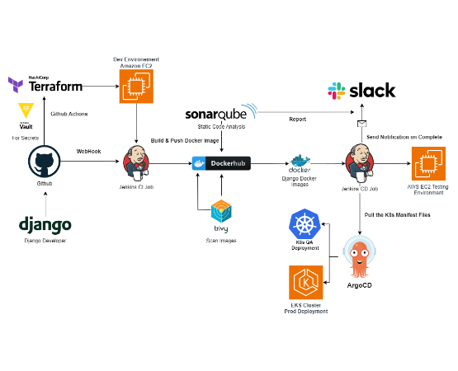
Use Case: CI/CD Pipelines
Automated Testing
CI/CD (Continuous Integration / Continuous Delivery) is about automated testing and deployment.
•
How do you ensure your test server is *identical* to production?
•
With Docker!
•
The pipeline builds a Docker image, runs automated tests *inside* that container, and if it passes, pushes that *exact* image to production.
•
Guarantees the code you tested is the code you run.

Slide 26
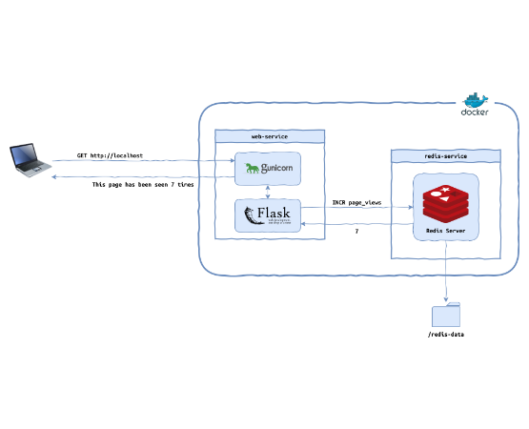
Use Case: Your Local Laptop
Clean & Simple Dev
You don't need to install Postgres, Redis, or RabbitMQ on your machine ever again!
•
Just run the official containers.
•
`docker run postgres` gives you a clean, isolated database.
•
`docker stop ...` makes it disappear. No cleanup, no conflicting versions.
•
Your `docker-compose.yml` file can spin up your *entire* app backend (web, db, cache) with one command.

Slide 27
Theory Demo

Slide 28
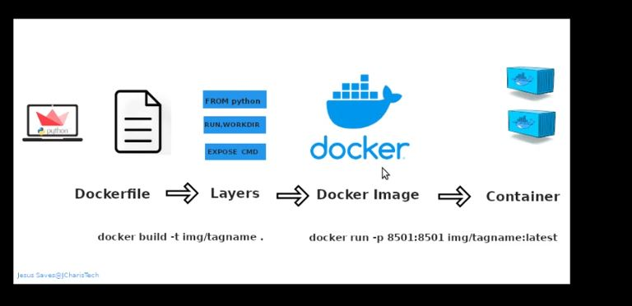
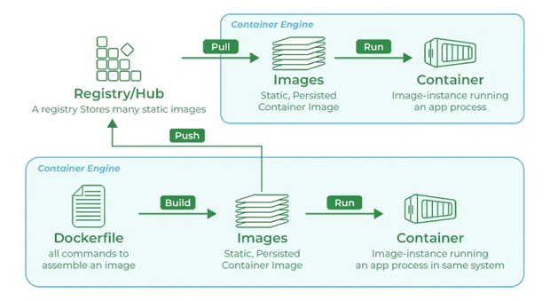
Notes:
Docker Engine is the official term for the core Docker software that runs containers. It includes:
The Docker daemon (dockerd)
The REST API
The CLI (docker)
Docker Server is not an official term, but some people use it informally to refer to the Docker Engine or the host running Docker.

Slide 29
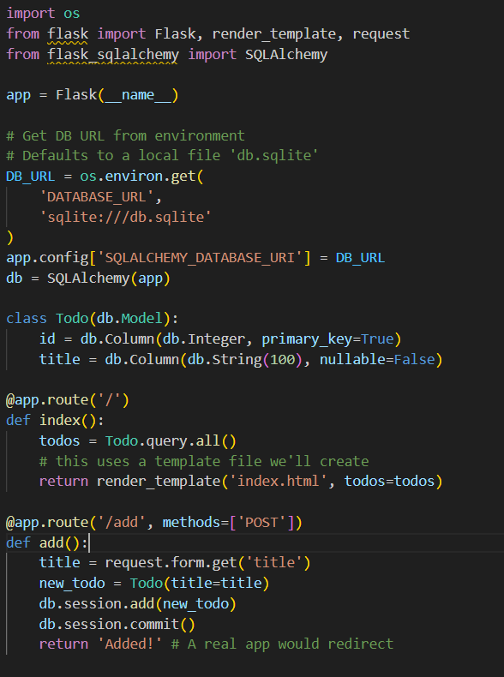
Example Setup: File 1: app.py
The Application
This is our simple Flask web app.
Key things to notice:
•
It uses Flask and SQLAlchemy.
•
It reads its database connection string from an environment variable named `DATABASE_URL`.
•
If that variable isn't set, it defaults to a local file named `db.sqlite`. This is what we'll use in Part 1.

Slide 30
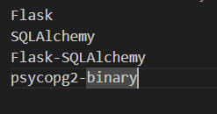
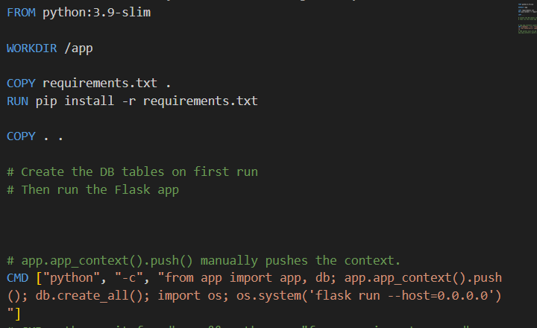
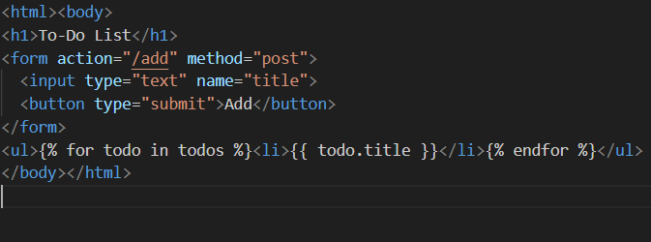
Example Setup: Files 2, 3, & 4
File 2: requirements.txt
File 4: Dockerfile
File 3: templates/index.html

Slide 31
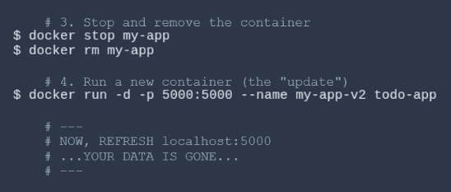
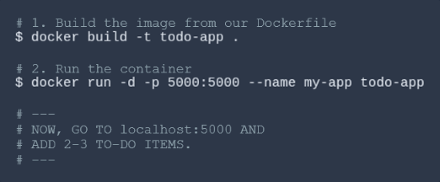
Example 1: The Commands
Step 1: Build & Run
Step 2: Remove & Re-run
Notes:
multiple times (with the same tag, e.g., my-image:latest), Docker does NOT create a new, separate image with a new name each time. Instead:
Docker creates a new image layer and assigns the specified tag (e.g., my-image:latest) to the new image.
The tag now points to the new image.
The old image is not immediately deleted—it remains in Docker’s local image storage, but it is untagged (called a "dangling image") unless no other tags point to it.
If no containers are using the old image, it may eventually be removed by Docker’s garbage collection (e.g., with docker image prune).
Is it mutable or immutable?
Docker images themselves are immutable—once created, their contents do not change.
Tags are mutable—the tag (like my-image:latest) can be moved to point to a new image, similar to how a variable in Python can point to a new objec

Slide 32
Wait... What Happens to My Data?
Before our next Theoretical demo, we need to solve one critical problem: Data Persistence.

Slide 33
Example 1: The Result
All our data is GONE!
"
"
This is because the `db.sqlite` file lived *inside* the container's temporary filesystem. When we ran `docker rm`, the container and its filesystem were destroyed.
We need to store our data *outside* the container.

Slide 34
The Problem: Containers are Stateless
Containers are Ephemeral (lasting for short period of time
- A container's filesystem is temporary. When a container is deleted, all data *inside* it is **lost forever**.
- This is a feature, not a bug! It keeps containers lightweight and clean.
- This is *good* for a web server (stateless).
- This is *terrible* for a database (stateful).
- We need to store our data *outside* the container.
Notes:
On Windows (with Docker Desktop), Docker runs inside a lightweight VM (using WSL2 or Hyper-V). The volume data is stored inside the VM’s virtual disk, not directly in your Windows file system.
You cannot easily browse these files with Windows Explorer.
The data persists as long as the volume exists, even if you delete containers.
In short:
Volume = storage, not a container, not running code. A volume is just a folder or storage area managed by Docker. It does not run any code, does not have processes, and is not a container. It is used to store data that containers can read from and write to.
Container = runs your app, can use volumes for data.
Network = lets containers talk to each other.

Slide 35

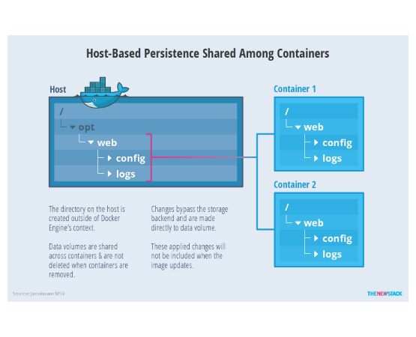
The Solution: Docker Volumes
Persistent Data
A Volume is a persistent data storage area managed *by Docker*.
It's a special folder that lives on the *host machine*, outside the container's file system.
We can "attach" this volume to a container.
When the container is deleted, the volume (and your data) **remains safe**.
Notes:
This image illustrates host-based persistence shared among containers using Docker volumes.
Host: The large box represents your physical or virtual machine (the host) where Docker is running. Inside the host, there is a directory (e.g., /opt/web/config and /opt/web/logs).
Containers: There are two containers (Container 1 and Container 2), each running an app that expects to read/write to /web/config and /web/logs.
Volume Mounting: Both containers are configured to mount the host’s /opt/web/config and /opt/web/logs directories into their own file systems at /web/config and /web/logs. This means any changes made by either container to these directories are reflected on the host and shared between containers.
What does "directory on the host is created outside Docker Engine" mean?
"Outside Docker Engine" means the directory is part of your host’s regular file system, not inside Docker’s internal storage or the container’s writable layer.
On Windows: Yes, this directory is created in your Windows file system (e.g., C:\Users\YourName\some-folder), and you can access it with File Explorer or any other tool.
On Linux/Mac: It’s a regular directory (e.g., /opt/web/config) on your host OS.
In summary: The data is stored in a normal folder on your computer, not inside the container or hidden by Docker.

Slide 36
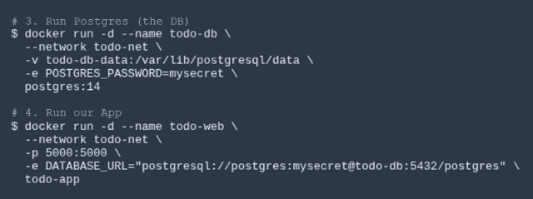
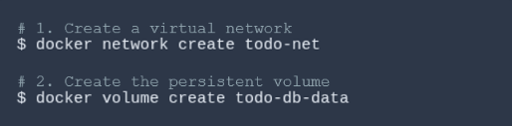
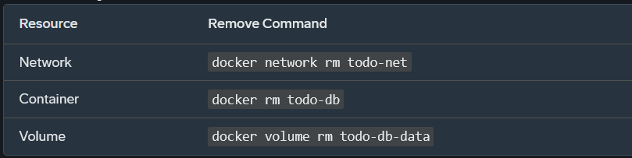
Example 2: The Commands (The "Hard Way")
Step 1: Network & Volume
First, we create a virtual network and our persistent volume.
Step 2: Run Containers
Now we run the DB, then the web app, connecting them all manually.

Slide 37
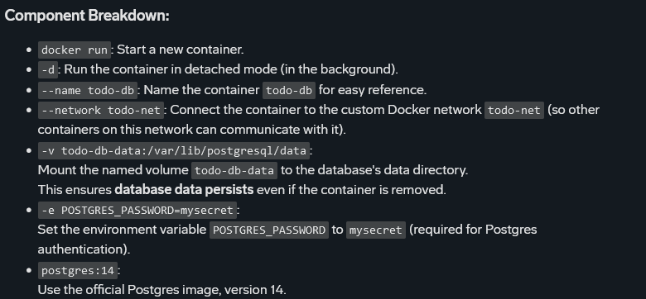
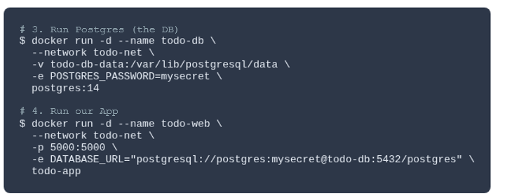
Example 2: The Commands (The "Hard Way")

Slide 38
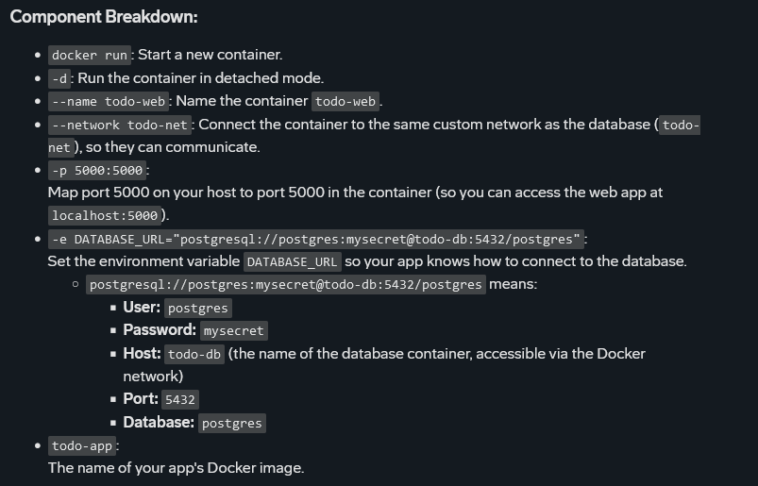
Example 2: The Commands (The "Hard Way")

Slide 39
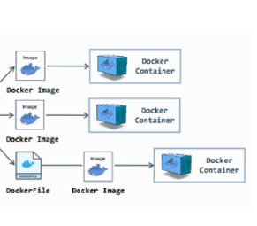
The Next Problem: Multi-Container Apps
This is Getting Complicated...
Okay, so our app needs:
1.
A `docker volume create` command.
2.
A `docker run` command for our database.
3.
A `docker run` command for our web app.
4.
A `docker network` command to link them...
This is a lot to remember and type just to run our app. There has to be a better way.

Slide 40
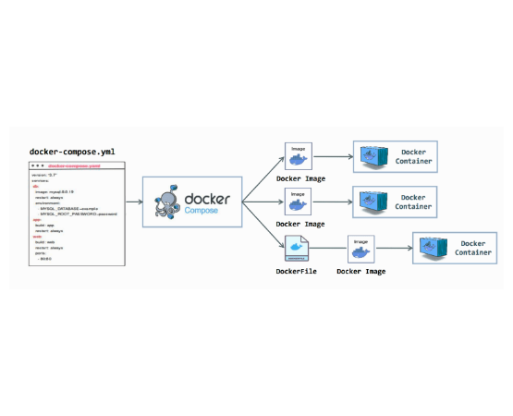
The Solution: Docker Compose
The "Easy Button"
Docker Compose is a tool for *defining* and *running* multi-container applications.
•
You use a single, simple YAML file: `docker-compose.yml`.
•
In this file, you define all your services (web, db), volumes, and networks.
•
One file to rule them all.
•
One command to bring your *entire* application up or down.

Slide 41
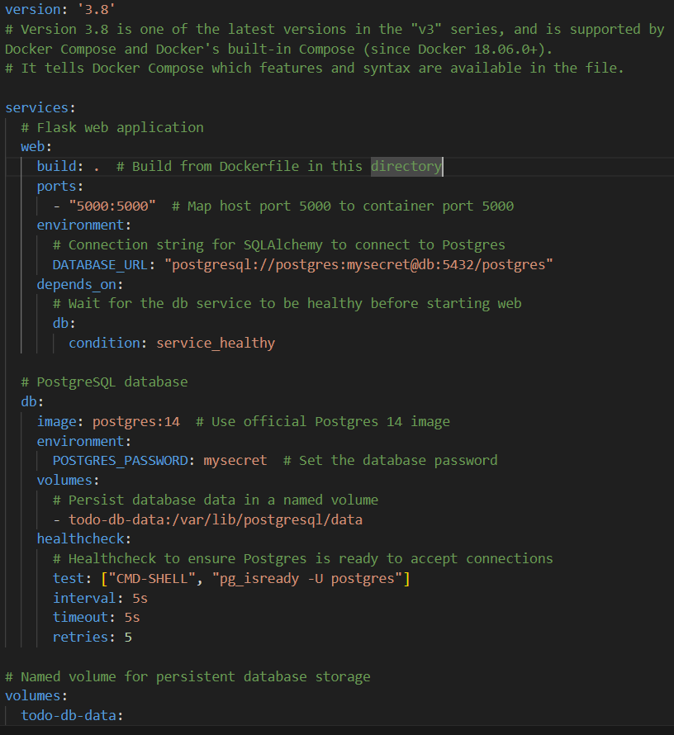
Example 3: The docker-compose.yml File
File 5: `docker-compose.yml`
Anatomy of the File
This file defines our entire app:
•
`services`: Our containers.
•
`web`: Our Python app. It `build`s from our Dockerfile and `depends_on` the db.
•
`db`: Our database. It uses the `postgres:14` image and a password.
•
`volumes`: We define our volume `todo-db-data` and attach it to the `db` service.
Compose handles the network *automatically*.

Slide 42
Example Part 3: The Final Commands
Your directory now has all your app files *and* the new `docker-compose.yml` file. Now the magic happens.
`docker-compose up`
`docker-compose up -d`: Detached mode, so we get our terminal back
`docker-compose down`: only removes containers but data persists
`docker-compose down -v`: remove named volumes declared in the volumes; section of the Compose file

Slide 43
Notes:
Docker Engine is the official term for the core Docker software that runs containers. It includes:
The Docker daemon (dockerd)
The REST API
The CLI (docker)
Docker Server is not an official term, but some people use it informally to refer to the Docker Engine or the host running Docker.

Slide 44
Notes:
Docker Engine is the official term for the core Docker software that runs containers. It includes:
The Docker daemon (dockerd)
The REST API
The CLI (docker)
Docker Server is not an official term, but some people use it informally to refer to the Docker Engine or the host running Docker.

Slide 45
Practical Demo

Slide 46
Agenda
AI/ML Training 2025
Boeing Artificial Intelligence
Topic |  | Duration
Introduction to Cloud Deployment |  | 5 min
Kubernetes Architecture |  | 5 min
Docker → K8s Manifests → Helm |  | 5 min
Overview Deployment Process |  | 10 min
LIVE: Deploy to OpenShift |  | 30 min
Scaling + Monitoring |  | 5 min

Slide 47
What You'll Deploy in the Next 1 Hours
Boeing Artificial Intelligence
AI/ML Training 2025
🚀 Deploying LLMs at Scale:
Docker → Kubernetes → Helm → OpenShift
Prerequisite :
- Docker Desktop (Windows)
Helm
OpenShift
What YOU Will Launch LIVE:
LLM Chatbot
⚡ FastAPI + Streaming responses
🛠 Runs on CPU
🌐 HTTPS URL
Not subject to U.S. Export Administration Regulations (EAR) (15 C.F.R. Parts 730-774) or U.S. International Traffic in Arms Regulations (ITAR), (22 C.F.R. Parts 120-130)

Slide 48
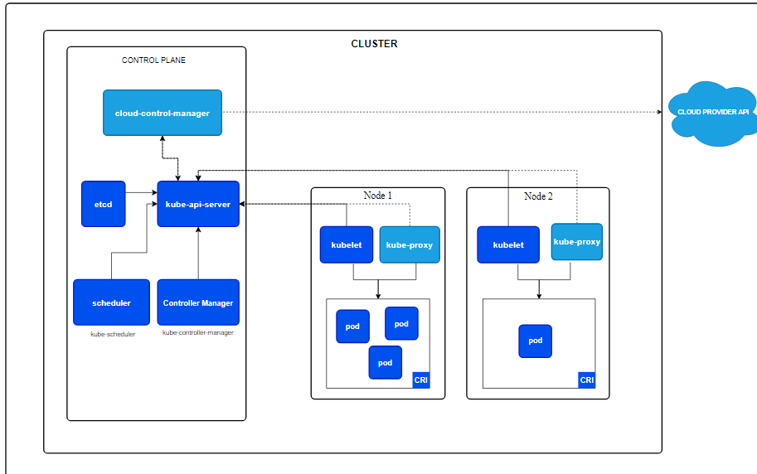
Kubernetes Architecture
Boeing Artificial Intelligence
AI/ML Training 2025
Not subject to U.S. Export Administration Regulations (EAR) (15 C.F.R. Parts 730-774) or U.S. International Traffic in Arms Regulations (ITAR), (22 C.F.R. Parts 120-130)

Slide 49
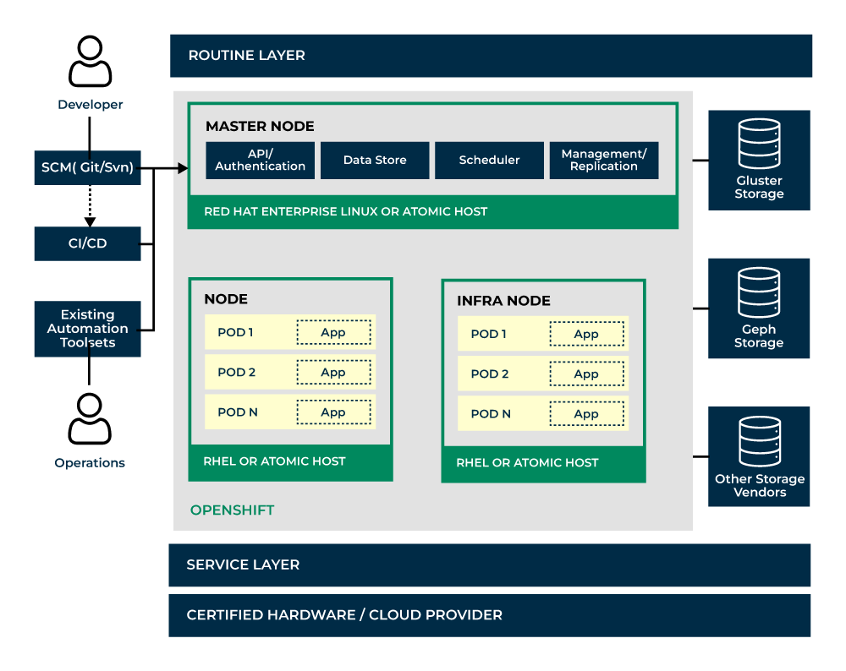
OpenShift Architecture
Boeing Artificial Intelligence
AI/ML Training 2025

Slide 50
Introduction to Kubernetes Manifests
Boeing Artificial Intelligence
AI/ML Training 2025
Kubernetes manifest files are YAML or JSON configurations that describe the desired state of your Kubernetes objects.
Key objects include Pods, Services, Deployments, ConfigMaps, Secrets, and more.
In this presentation, we’ll go over the most important Kubernetes objects used in manifests.
Not subject to U.S. Export Administration Regulations (EAR) (15 C.F.R. Parts 730-774) or U.S. International Traffic in Arms Regulations (ITAR), (22 C.F.R. Parts 120-130)

Slide 51
Demo Objects
AI/ML Training 2025
Boeing Artificial Intelligence
Object | Job | Demo App
Deployment | Run N replicas + auto-restart | replicas: 3 → 10 with HPA
Service | Expose pods (ClusterIP/NodePort) | Load-balances traffic to 3 pods
Route | OpenShift HTTPS ingress | Public URL in 3 seconds
ConfigMap | Environment Variable | Sample vars
Secret | Passwords / tokens | API token
HPA | Auto-scale on CPU / RPS | 2 → 10 pods when traffic spikes

Slide 52
Pods
AI/ML Training 2025
Boeing Artificial Intelligence
A Pod is the smallest and simplest Kubernetes object. It represents a single instance of a running process in your cluster.
Key Fields in Pod Manifest:
apiVersion: Specifies the version of the Kubernetes API (e.g., v1).
kind: Defines the object type, which is Pod.
metadata: Contains name, labels, and other metadata
.spec: Describes the containers, their images, volumes, and ports
apiVersion: v1
kind: Pod
metadata:
name: my-pod
spec:
containers:
- name: nginx-container
image: nginx
ports:
- containerPort: 80
Not subject to U.S. Export Administration Regulations (EAR) (15 C.F.R. Parts 730-774) or U.S. International Traffic in Arms Regulations (ITAR), (22 C.F.R. Parts 120-130)

Slide 53
Deployments
AI/ML Training 2024
Boeing Artificial Intelligence
apiVersion: apps/v1
kind: Deployment
metadata:
name: nginx-deployment
spec:
replicas: 3
selector:
matchLabels:
app: nginx
template:
metadata:
labels:
app: nginx
spec:
containers:
- name: nginx
image: nginx:1.14.2
ports:
- containerPort: 80
A Deployment provides declarative updates for Pods and ReplicaSets.
Key Fields in Deployment Manifest:
replicas: Defines the number of Pod replicas to run.
selector: Specifies how Pods are selected for the deployment.
template: Describes the Pod definition.
Not subject to U.S. Export Administration Regulations (EAR) (15 C.F.R. Parts 730-774) or U.S. International Traffic in Arms Regulations (ITAR), (22 C.F.R. Parts 120-130)

Slide 54
Services
AI/ML Training 2025
Boeing Artificial Intelligence
A Service defines how to expose a set of Pods to network traffic.
Key Fields in Service Manifest:
type: Defines the type of Service (e.g., ClusterIP, NodePort, LoadBalancer).
selector: Defines how to select the Pods for this service.
ports: Specifies the port mapping for the service
apiVersion: v1
kind: Service
metadata:
name: my-service
spec:
selector:
app: nginx
ports:
- protocol: TCP
port: 80
targetPort: 80
Not subject to U.S. Export Administration Regulations (EAR) (15 C.F.R. Parts 730-774) or U.S. International Traffic in Arms Regulations (ITAR), (22 C.F.R. Parts 120-130)

Slide 55
ConfigMaps & Secrets
AI/ML Training 2025
Boeing Artificial Intelligence
apiVersion: v1
kind: ConfigMap
metadata:
name: my-config
data:
database_url: localhost
api_key: abc123
ConfigMaps store configuration data as key-value pairs.
Key Fields in ConfigMap
Manifest: data: Holds the configuration data as key-value pairs.
Secrets store sensitive data such as passwords, tokens, or keys.
Key Fields in Secrets
Manifest: data: Stores sensitive data in base64-encoded form.
apiVersion: v1
kind: Secret
metadata:
name: my-secret
data:
password: cGFzc3dvcmQ=
Not subject to U.S. Export Administration Regulations (EAR) (15 C.F.R. Parts 730-774) or U.S. International Traffic in Arms Regulations (ITAR), (22 C.F.R. Parts 120-130)

Slide 56
Blue/Green Deployment & Rolling Deployment Strategy
AI/ML Training 2025
Boeing Artificial Intelligence
What is Blue/Green Deployment?
Blue/Green Deployment is a deployment strategy where two identical environments, Blue (old) and Green (new), are used.
- Traffic is switched between these environments.
- Green environment is tested before switching all traffic from Blue to Green.
- If issues arise, rollback to Blue is easy.
What is Rolling Deployment?
A Rolling Deployment is a strategy that updates one instance of the application at a time until the entire environment is updated.
- Reduces downtime since the application is always available during the deployment.
- Slower deployment compared to Blue/Green, but less resource-intensive.
- Can easily roll back to the previous version if an issue is detected.
Not subject to U.S. Export Administration Regulations (EAR) (15 C.F.R. Parts 730-774) or U.S. International Traffic in Arms Regulations (ITAR), (22 C.F.R. Parts 120-130)

Slide 57
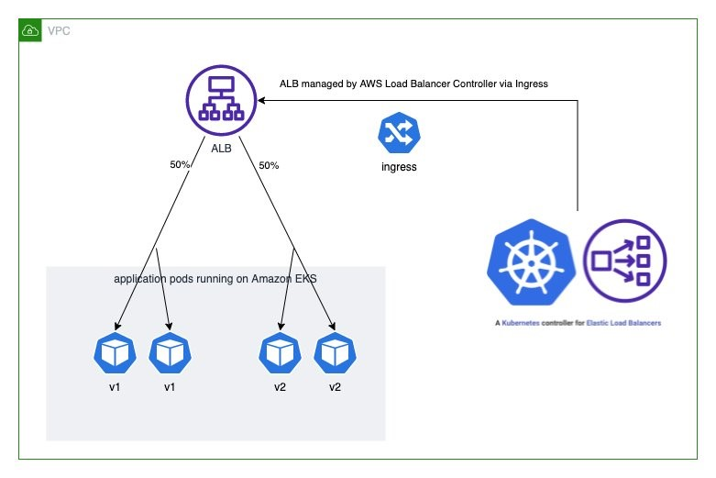
Blue/Green Deployment
AI/ML Training 2025
Boeing Artificial Intelligence
Not subject to U.S. Export Administration Regulations (EAR) (15 C.F.R. Parts 730-774) or U.S. International Traffic in Arms Regulations (ITAR), (22 C.F.R. Parts 120-130)

Slide 58
Assignment
AI/ML Training 2025
Boeing Artificial Intelligence
Deploy Neural Network Model on any Deployment Platform to predict the admission .
Create a Dockerfile
Build & Push to any container registry
Create Helm App
Deploy the App using Deployment object
Add HPA based on Memory Utilization

Slide 59

AI/ML Training 2025
Boeing Artificial Intelligence
Ref docs for practicing ML Models deployment on AWS SageMaker: https://huggingface.co/docs/sagemaker/en/inference
Not subject to U.S. Export Administration Regulations (EAR) (15 C.F.R. Parts 730-774) or U.S. International Traffic in Arms Regulations (ITAR), (22 C.F.R. Parts 120-130)

Slide 60
Questions?
Thank you.

Slide 61






Image Sources
https://preview.redd.it/nxxps4mgw8j11.jpg?auto=webp&s=f1736db962e5218dcc65ad84a20cba612e125be5
Source: www.reddit.com
https://static.vecteezy.com/system/resources/thumbnails/065/014/287/small/data-storage-server-database-stack-with-blue-indicator-lights-in-simple-isometric-style-illustration-vector.jpg
Source: www.vecteezy.com
https://media.geeksforgeeks.org/wp-content/uploads/20250823130235313168/virtual_machines.webp
Source: www.geeksforgeeks.org
https://static.vecteezy.com/system/resources/previews/069/333/114/non_2x/slow-snail-speed-icon-acceleration-or-jerk-slug-flat-symbol-on-white-background-illustration-vector.jpg
Source: www.vecteezy.com
https://media2.dev.to/dynamic/image/width=1600,height=900,fit=cover,gravity=auto,format=auto/https%3A%2F%2Fdev-to-uploads.s3.amazonaws.com%2Fuploads%2Farticles%2Ft10gi93stsg40dtsnz6s.jpg
Source: dev.to
https://miro.medium.com/v2/resize:fit:1400/1*mq2QpIZUnfmnDPn47spI4A.jpeg
Source: blog.devops.dev

Slide 62
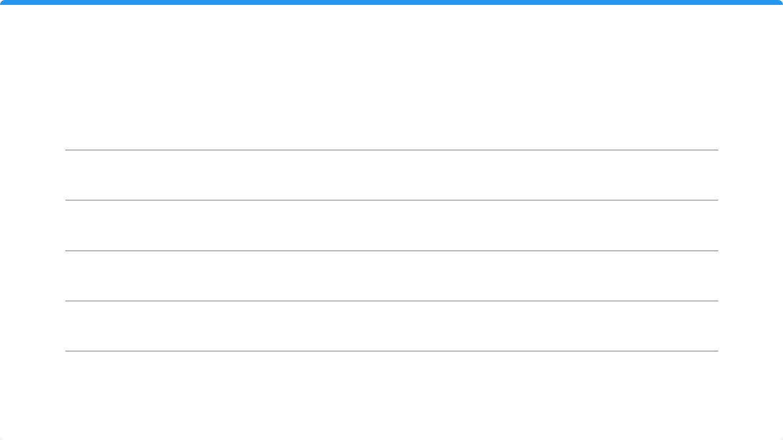






Image Sources
https://miro.medium.com/1*GoZ56yZNpG_VnGGvqhYlCQ.png
Source: medium.com
https://upload.wikimedia.org/wikipedia/commons/thumb/0/0e/Toicon-icon-blueprint-explain.svg/1200px-Toicon-icon-blueprint-explain.svg.png
Source: commons.wikimedia.org
https://earthly.dev/blog/assets/images/docker-image-storage-on-host/layer.png
Source: earthly.dev
https://static.vecteezy.com/system/resources/thumbnails/019/015/401/small_2x/shipping-containers-colored-icons-set-intermodal-freight-container-signs-vector.jpg
Source: www.vecteezy.com
https://miro.medium.com/1*uuZ-h5EH76LOtJ614z-qDA.png
Source: medium.com
https://i.ytimg.com/vi/dQlk7uIjhEc/maxresdefault.jpg
Source: www.youtube.com

Slide 63
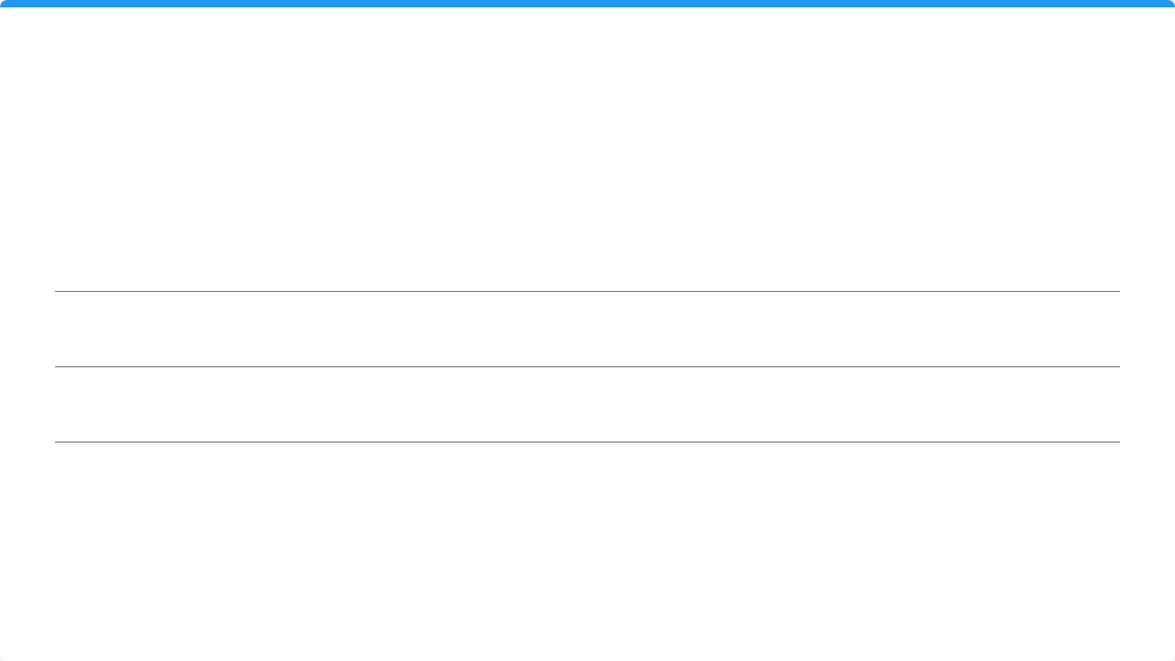




Image Sources
https://miro.medium.com/v2/resize:fit:1200/1*aSdnOJNT2UoiaAhy-vuV_Q.png
Source: icepanel.medium.com
https://miro.medium.com/v2/resize:fit:1015/1*rlPRYAfJ_aFOfoj52U7y2A.png
Source: medium.com
https://files.realpython.com/media/page_tracker_architecture.drawio_2.1c8cf20462ae.png
Source: realpython.com
https://media.istockphoto.com/id/1474410944/photo/large-container-ship-in-harbour-on-a-clear-summer-day.jpg?s=612x612&w=is&k=20&c=nAShs46jSHXqpyhXUeBm50Yh_OgGyK8A6_-xVu7eocU=
Source: www.istockphoto.com

